Slide 1
毛宽诚进度汇报 2018/6-2018/10
毛宽诚
2018/10/15

Slide 2
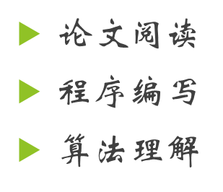
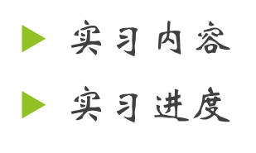
1 课题 2 实习

Slide 3
课题开展：
多谱行人检测
论文阅读
Multispectral Pedestrian Detection: Benchmark Dataset and Baseline
Fast Feature Pyramids for Object Detection
Hwang S, Park J, Kim N, et al. Multispectral pedestrian detection: Benchmark dataset and baseline[C]// Computer Vision and Pattern Recognition. IEEE, 2013:1037-1045.
Wagner J, Fischer V, Herman M, et al. Multispectral Pedestrian Detection using Deep Fusion Convolutional Neural Networks
Liu J, Zhang S, Wang S, et al. Multispectral Deep Neural Networks for Pedestrian Detection[J]. 2016.
König D, Adam M, Jarvers C, et al. Fully Convolutional Region Proposal Networks for Multispectral Person Detection[C]// IEEE Conference on Computer Vision and Pattern Recognition Workshops. IEEE Computer Society, 2017:243-250.
Li C, Song D, Tong R, et al. Illumination-aware Faster R-CNN for Robust Multispectral Pedestrian Detection[J]. 2018.

Slide 4
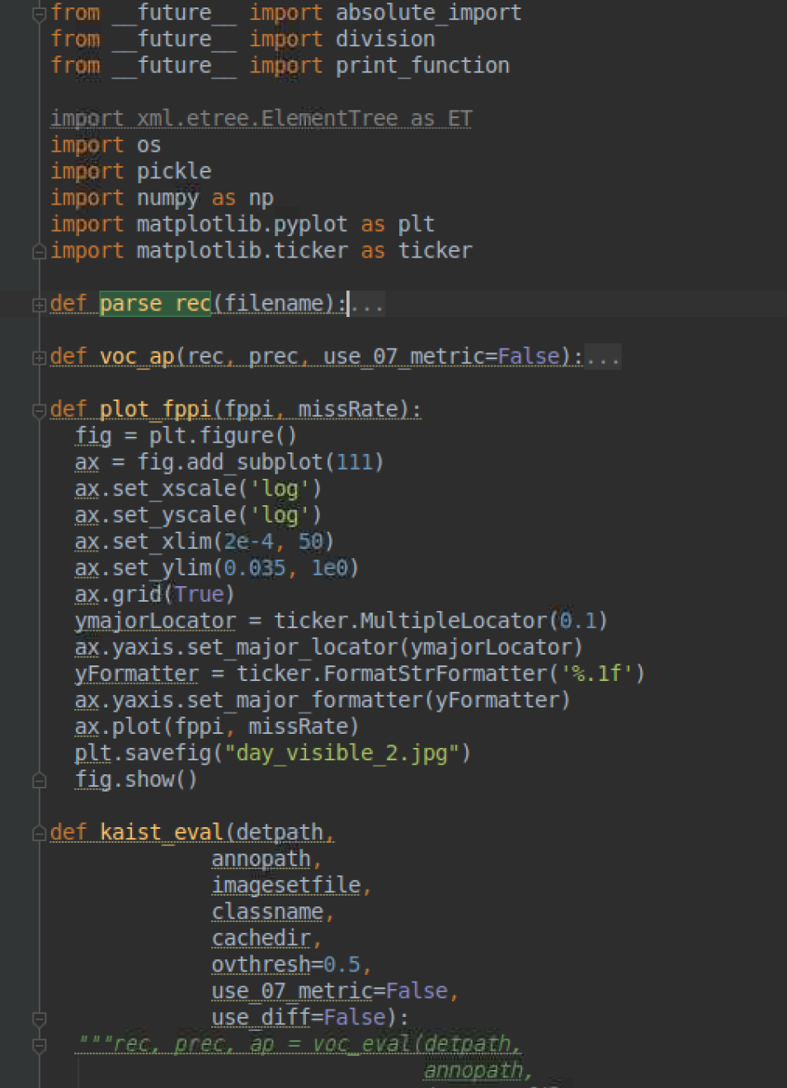
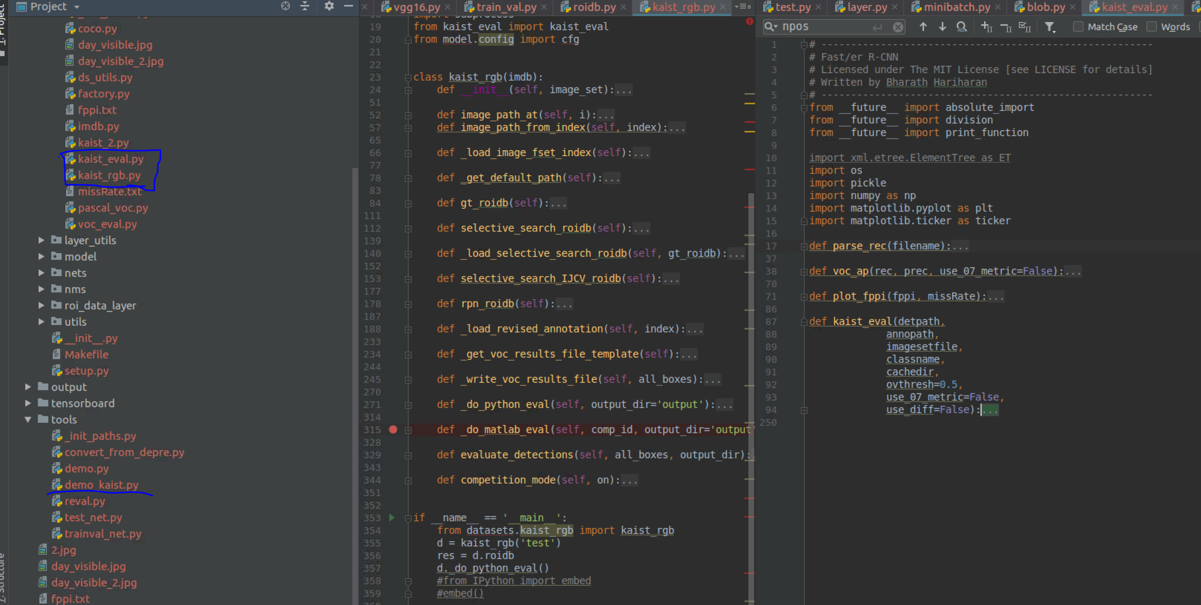
程序编写
Kaist 数据集 数据读取接口
Kaist 数据集 模型评价指标
https://github.com/endernewton/tf-faster-rcnn
https://github.com/yhenon/keras-frcnn

Slide 5
算法理解
faster rcnn 论文阅读
Ren S, He K, Girshick R, et al. Faster R-CNN: towards real-time object detection with region proposal networks[C]// International Conference on Neural Information Processing Systems. MIT Press, 2015:91-99.
Faster rcnn 程序阅读
https://www.cnblogs.com/dudumiaomiao/p/6560841.html
https://www.cnblogs.com/wangyong/p/8513563.html

Slide 6
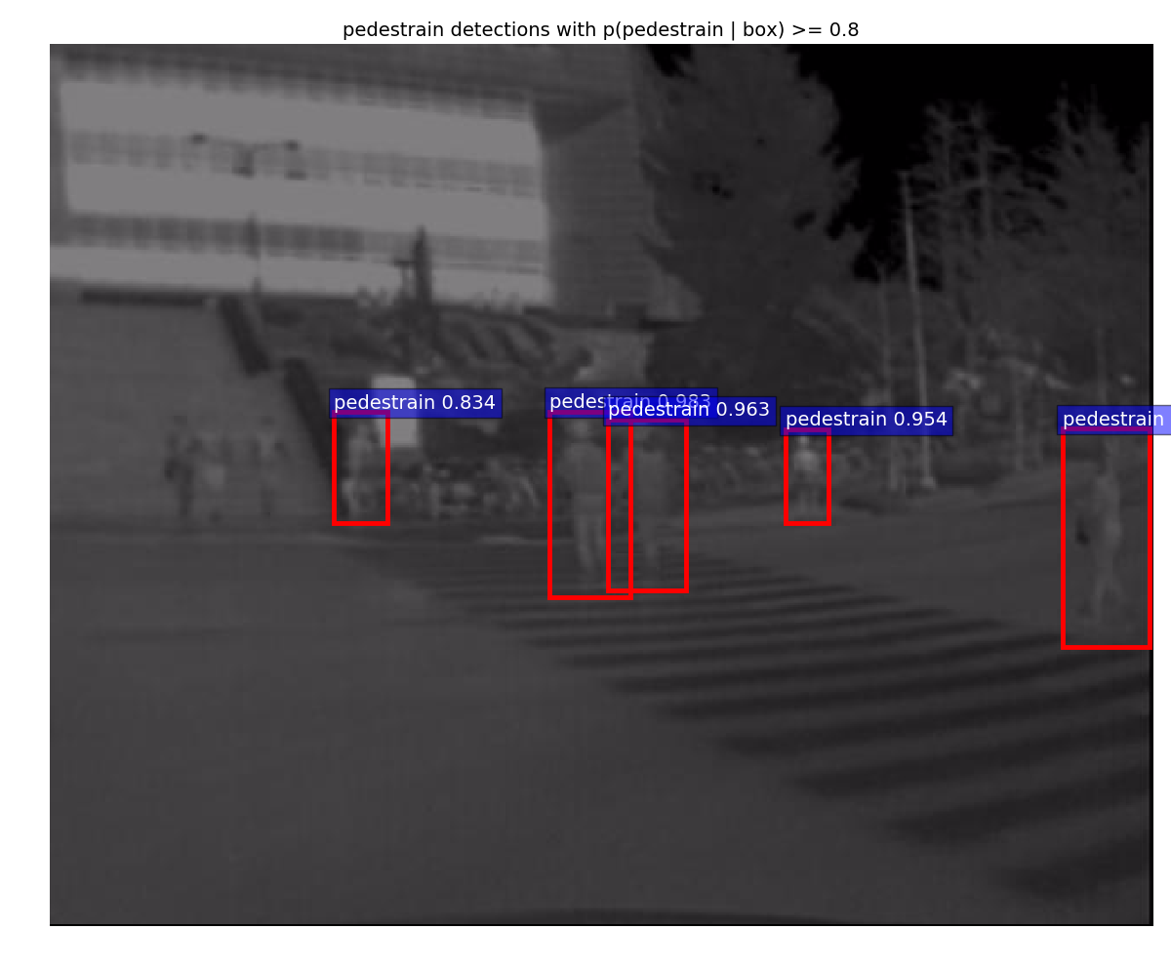
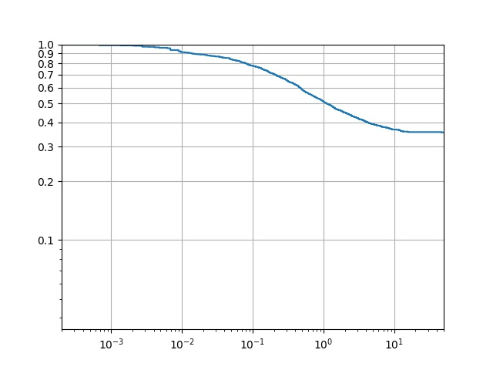
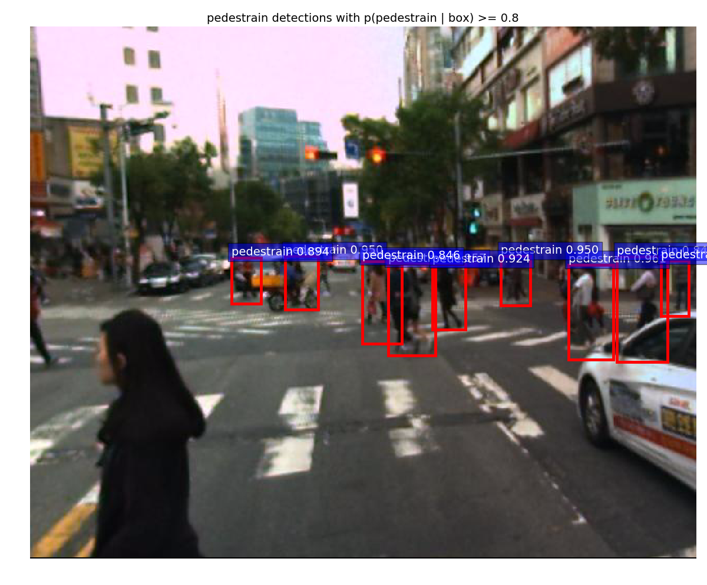
模型展示
Rgb model
Thermal model

Slide 7
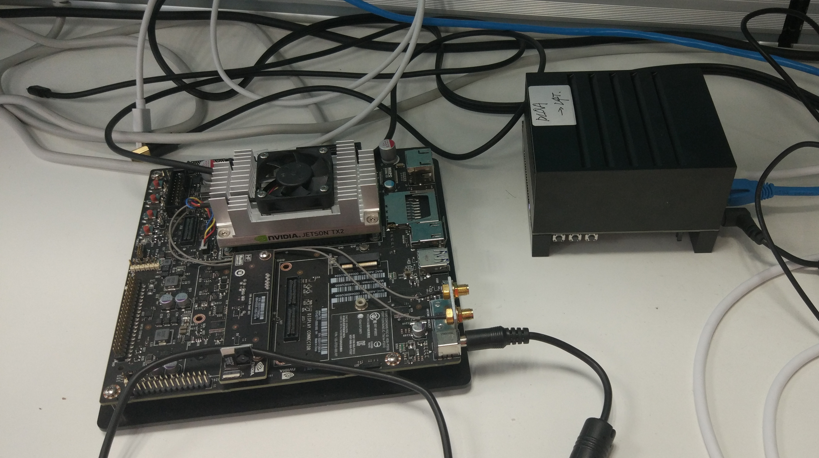
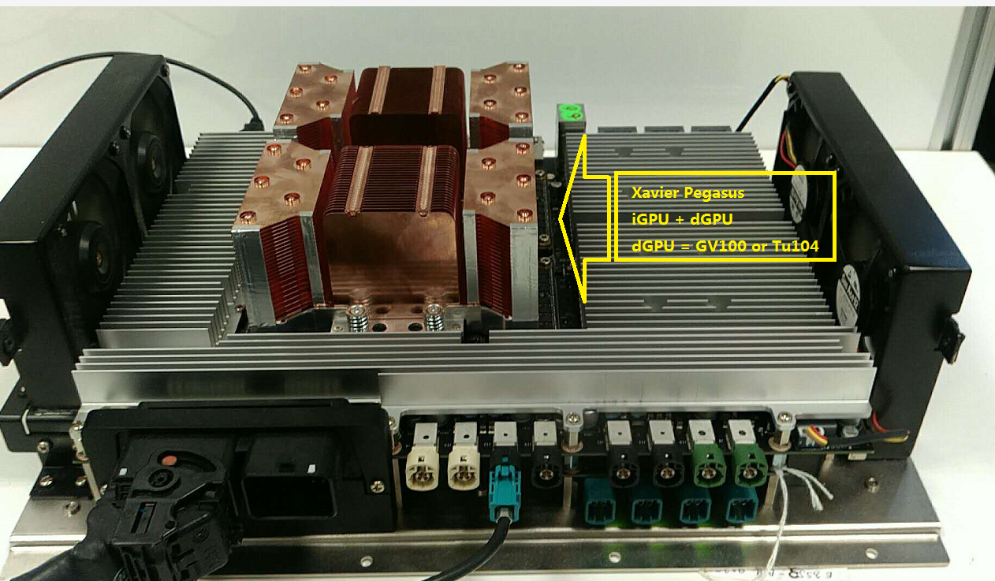
实习
实习内容
Tensorrt(深度学习加速软件包) 在mobile 平台上测试
实习时间
一周四天
与课题相关性
与课题是紧密相连的，如果利用好
多谱模型 + 软件加速 + 硬件实现
接下来实习安排
尽快将课题完成，并实现于公司硬件上。

Slide 8
下一步工作： 1,深入理解fasterrcnn 程序 2,编写rgb+ t fusion model 3,移植到移动平台

Slide 9
Thanks

